Slide 1

XHTML

Slide 2
XHTML
XHTML stands for EXtensible HyperText Markup Language
XHTML is almost identical to HTML
XHTML is stricter than HTML
XHTML is HTML defined as an XML application
XHTML is supported by all major browsers

Slide 3
Most Important Differences from HTML:
Document Structure
XHTML DOCTYPE is mandatory
The xmlns attribute in <html> is mandatory
<html>, <head>, <title>, and <body> are mandatory
XHTML Elements
XHTML elements must be properly nested
XHTML elements must always be closed
XHTML elements must be in lowercase
XHTML documents must have one root element
XHTML Attributes
Attribute names must be in lower case
Attribute values must be quoted
Attribute minimization is forbidden

Slide 4
Most Important Differences from HTML(Conti.):
<input type="checkbox" name="vehicle" value="car" checked="checked" />

Slide 5
XHTML syntax
<?xml version="1.0" encoding="UTF-8"?>
<!DOCTYPE html PUBLIC "-//W3C//DTD XHTML 1.0 Transitional//EN" "http://www.w3.org/TR/xhtml1/DTD/xhtml1-transitional.dtd">
<html xmlns="http://www.w3.org/TR/xhtml1" xml:lang="en" >
<head>
<title>Every document must have a title</title>
</head>
<body>
...your content goes here...
</body>
</html>

Slide 6
HTML

Slide 7
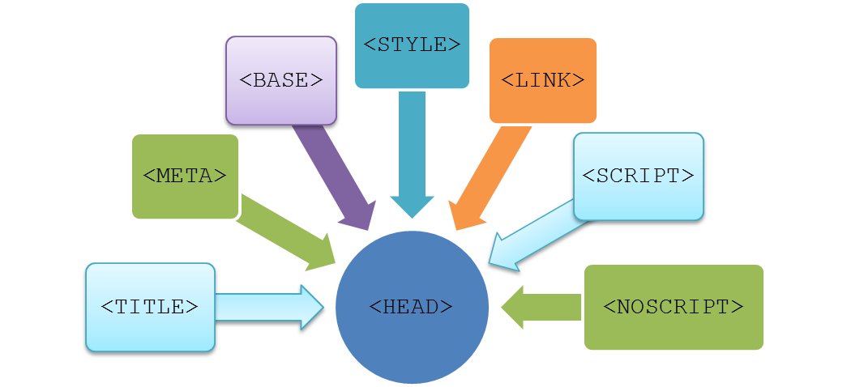

Exploring the <HEAD> Tag
The <HEAD> tag:
  Is contained within the <HTML> and </HTML> tags.
  Is used to define the header of the HTML document.
  Can include the following tags:

Slide 8
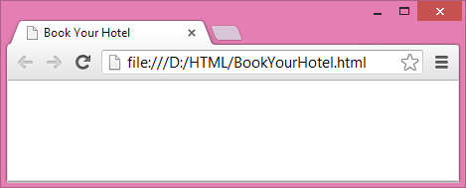
Exploring the <HEAD> Tag (Contd.)
The <TITLE> tag:
  Defines the title of the document.
  Can appear only once in the HTML document.
  For example:
<HEAD>
<TITLE> Book Your Hotel</TITLE>
</HEAD>

Slide 9

Exploring the <HEAD> Tag (Contd.)
The <META> tag:
  Provides additional information about the current document in the form of name and value pairs.
  For example:
<META name="description" content="This website provides you the benefit of booking rooms in the best hotels of US">
<META name="keywords" content="hotel, online, booking">
<META name="author" content="Harry Anem">
<META http-equiv="refresh" content="30">

Slide 10

The <STYLE> tag:
  Defines the style information associated with the HTML document.
The <SCRIPT> tag:
  Specifies the client-side script, such as JavaScript, associated with the document.
The <LINK> tag:
Is used to establish the relationship of the current document with other documents in a website.

Slide 11
Exploring the <BODY> Tag
The body section:
  Is the central part of the HTML document required to display content on the Web page.
  Begins with the <BODY> tag.
  Contains the actual visible content of an HTML document.

Slide 12
Exploring the <BODY> Tag (Contd.)
The content of a Web page can be formatted by using the following tags:
<B>
<I>
<U>
<HR>

Slide 13
Exploring the <BODY> Tag (Contd.)
HTML Headings
Headings are defined with the <h1> to <h6> tags.
<h1> defines the most important heading.
<h6> defines the least important heading.
Eg:
<h1>This is heading 1</h1>
<h2>This is heading 2</h2>
<h3>This is heading 3</h3>
<h4>This is heading 4</h4>
<h5>This is heading 5</h5>
<h6>This is heading 6</h6>
<h1>
<h2>
<h3>
<h4>
<h5>
<h6>

Slide 14
HTML Paragraphs
The HTML <p> element defines a paragraph.Browsers automatically add some white space before and after a paragraph.
Eg: <p>This is a paragraph</p>
<p>This is another paragraph</p>
The HTML <br/> tag can be used to insert line breaks in paragraphs. <p>This is a paragraph with <br/> in here and <br/> here </p>
<BR>

Slide 15
Exploring the <BODY> Tag (Contd.)
Images are added to a web page to enhance its visual appeal.
Images can in the following formats:
- JPEG (Joint Photographic Experts Group)
- GIF (The Graphics Interchange Format)
- PNG( Portable Network Graphics)
JPEG
GIF
PNG

Slide 16
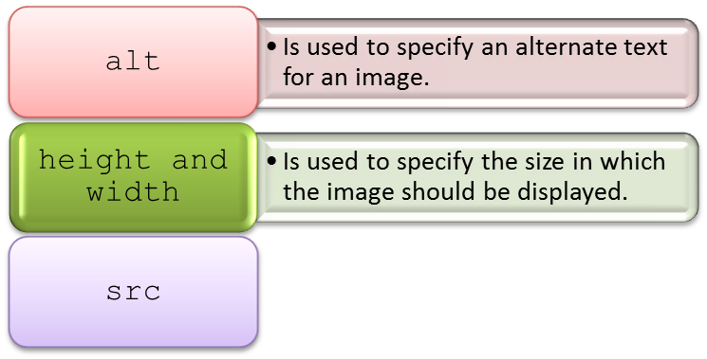
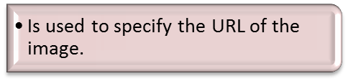

Exploring the <BODY> Tag (Contd.)
  Using the <IMG> tag that has the following attributes:

Slide 17
HTML Links
HTML links are hyperlinks.
A hyperlink is a text or an image you can click on, and jump to another document.
In HTML, links are defined with the <a> tag:
Eg:
<a href="url">link text</a>
The href attribute specifies the destination address
The link text is the visible part.
Clicking on the link text, will send you to the specified address.
The link text does not have to be text. It can be an HTML image or any other HTML element.

Slide 18
Target Value Description
_blank Opens the linked document in a new window or tab.
_self Opens the linked document in the same frame as it was clicked (this is default).
_parent Opens the linked document in the parent frame.
_top Opens the linked document in the full body of the window.
framename Opens the linked document in a named frame.

Slide 19
HTML Lists
1.Unordered List
2.Ordered List
3.Description List
Unordered List:
Item
Item
Item
Item
Ordered List:
First item
Second item
Third item
Fourth item
A Description List
Coffee
- black hot drink
Milk
- white cold drink

Slide 20
A style attribute can be added to an unordered list, to define the style of the marker:
Style Description
list-style-type:disc The list items will be marked with bullets (default)
list-style-type:circle The list items will be marked with circles
list-style-type:square The list items will be marked with squares
list-style-type:none The list items will not be marked
A type attribute can be added to an ordered list, to define the type of the marker:
Type Description
(default)type="1" The list items will be numbered with numbers
letters type="A" The list items will be numbered with uppercase
letters type="a" The list items will be numbered with lowercase
roman numbers type="I" The list items will be numbered with uppercase roman numbers type="i" The list items will be numbered with lowercase

Slide 21
HTML Iframes
An iframe is used to display a web page within a web page.
The syntax for adding an iframe is
<iframe src="URL"></iframe>
The src attribute specifies the URL (web address) of the iframe page.
The target attribute of the link must refer to the name attribute of the iframe.
<iframe src="demo_iframe.htm" name="iframe_a"></iframe>
<p><a href="http://www.w3schools.com" target="iframe_a">W3Schools</a></p>
<iframe>

Slide 22
HTML Forms
HTML forms are used to collect user input.
HTML forms contain form elements.
Form elements are different types of input elements, checkboxes, radio buttons, submit buttons, and more.
Syntax
<form>
form elements
</form>

Slide 23
The Action Attribute
The action attribute defines the action to be performed when the form is submitted.
The common way to submit a form to a server, is by using a submit button.
Normally, the form is submitted to a web page on a web server.
Eg:
<form action="action_page.php">
If the action attribute is omitted, the action is set to the current page.

Slide 24
The Method Attribute
The method attribute specifies the HTTP method (GET or POST) to be used when submitting the forms.
Eg:
<form action="action_page.php" method="get">
or:
<form action="action_page.php" method="post">
The Name Attribute
To be submitted correctly, each input field must have a name attribute.
Eg:
<form action="action_page.php">
<input type="text" value="Mickey"><br>
<input type="text" name="lastname" value="Mouse"><br><br>
<input type="submit" value="Submit">
</form>

Slide 25
HTML Form Attributes
An HTML <form> element, with all possible attributes set
Eg:
<form action="action_page.php" method="post" target="_blank" accept-charset="UTF-8"
enctype="application/x-www-form-urlencoded" autocomplete="off" novalidate>
form elements
</form>
Attribute Description
accept-charset -Specifies the charset used in the submitted form (default: the page charset).
action -Specifies an address (url) where to submit the form (default: the submitting page).
autocomplete -Specifies if the browser should autocomplete the form (default: on).
enctype -Specifies the encoding of the submitted data (default: is url-encoded).
method -Specifies the HTTP method used when submitting the form (default: GET).
name -Specifies a name used to identify the form (for DOM usage: document.forms.name).
novalidate -Specifies that the browser should not validate the form.

Slide 26
Form Elements
Dropdown List--
Mullti-line textbox-- <textarea></terxtarea>
Input fields – <input type=” ”>
<select>
<option></option>
</select>
button
checkbox
date
email
file
hidden
number
password
radio
reset
search
submit
text

Slide 27
Exploring the <BODY> Tag (Contd.)
Using the <table> tag
Tables provide a means of organising the layout of data
A table is divided into rows and columns: these specify the cells of the table
Cells can contain text, images, links, other tables...

Slide 28
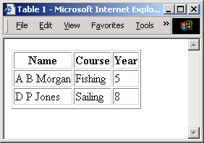
Exploring the <BODY> Tag (Contd.)
<table> main element
<tr> table row
<th> table header
<td> table data
<table border="1">
<tr>
<th>Name</th>
<th>Course</th>
<th>Year</th>
</tr>
<tr>
<td>A B Morgan</td>
<td>Fishing</td>
<td>5</td>
</tr>
<tr>
<td>D P Jones</td>
<td>Sailing</td>
<td>8</td>
</tr>
<tr>
</table>

Slide 29
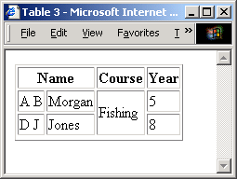
Exploring the <BODY> Tag (Contd.)
<table border="1">
<tr>
<th colspan="2">Name</th>
<th>Course</th>
<th>Year</th>
</tr>
<tr>
<td>A B</td>
<td>Morgan</td>
<td rowspan="2">Fishing</td>
<td>5</td>
</tr>
<tr>
<td>D J</td>
<td>Jones</td>
<td>8</td>
</tr>
<tr>
</table>
Cells can span multiple columns and multiple rows with the colspan and rowspan attributes

Slide 30
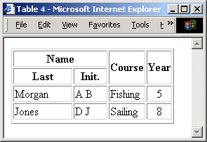
Exploring the <BODY> Tag (Contd.)
<table border="1" align="center">
<tr>
<th colspan="2" width="60%">Name</th>
<th rowspan="2">Course</th>
<th rowspan="2">Year</th>
</tr>
<tr>
<th>Last</th>
<th>Init.</th>
</tr>
<tr>
<td>Morgan</td>
<td>AB</td>
<td>Fishing</td>
<td align="center">5</td>
</tr>
<!– etc -->
The align attribute determines the position of the text within a cell
The width attribute determines the width of the row relative to the table

Slide 31
HTML Comments
Comment tags are used to insert comments in the HTML source code.
syntax:
<!-- Write your comments here -->
Notice that there is an exclamation point (!) in the opening tag, but not in the closing tag.
Comments are not displayed by the browser, but they can help document your HTML source code.

